Slide 1
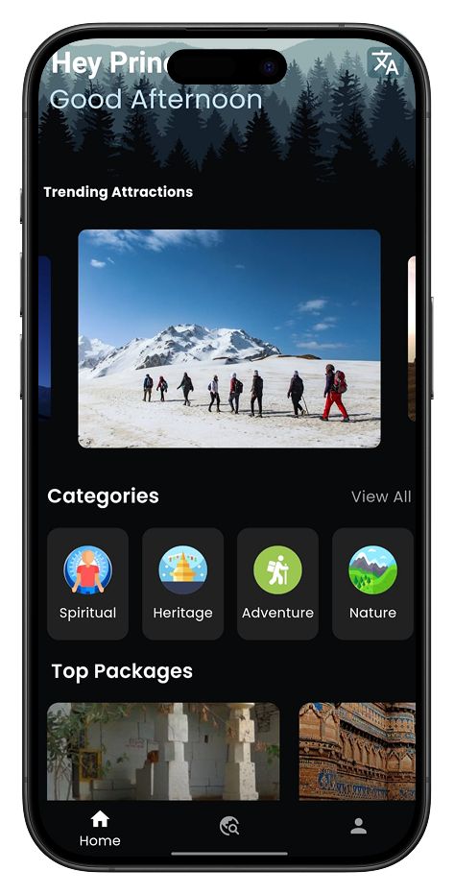


Your Personalized Travel Companion
Travel Minds is a dynamic and user-friendly travel application designed to simplify the process of planning, booking, and exploring travel experiences for modern-day travelers. The app integrates advanced technology to provide seamless access to travel information, booking facilities, personalized recommendations, and detailed travel packages.
Group No: 139 Guided By: Dr. Varsha Maurya
Presenters:
Bhutwala Prince (5249)
Buha Prince (5253)
Rajbhara Ariba (5679)
Chevli Riya KetanKumar 5268
Pryanshi jariwala (5400)

Slide 2
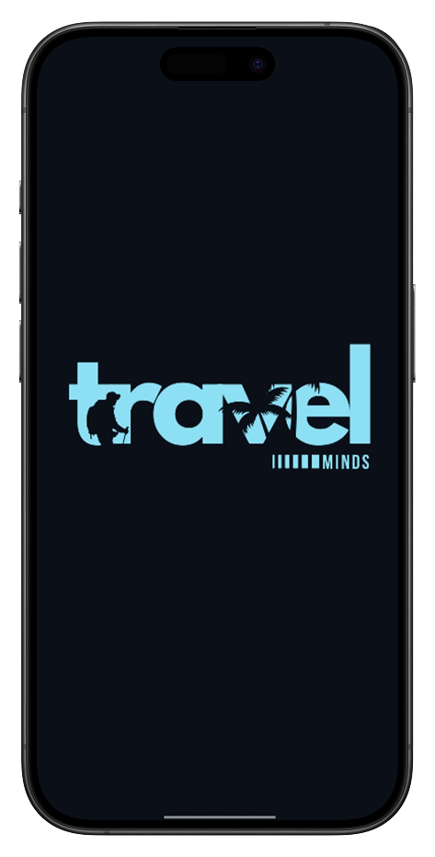
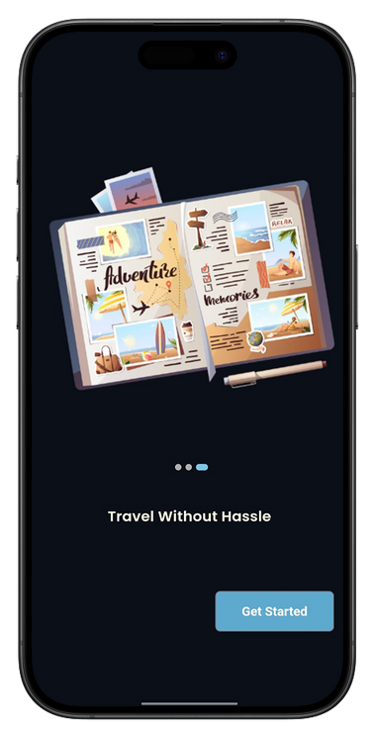
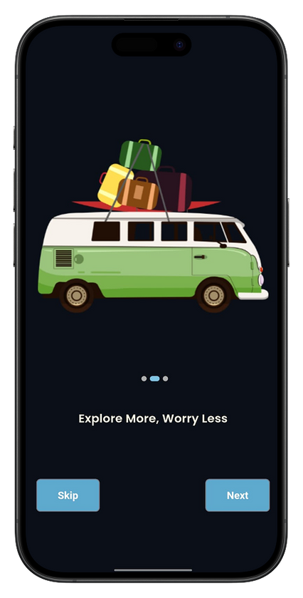
Description
Travel Minds is a modern travel application designed to simplify the entire travel experience for users. It replaces the complexity of traditional travel planning with a fast, secure, and user-friendly digital platform, offering features like personalized travel package recommendations, seamless booking, and a rewarding loyalty program.
With Travel Minds, users can effortlessly discover and book flights, hotels, and comprehensive travel packages, receive real-time updates, and manage their travel preferences—all from their smartphones and web browsers. It provides a simple, efficient, and inspiring solution for planning and enjoying memorable travel experiences.

Slide 3





TEAM MEMBERS
Bhutwala Prince (5249)
Backend Developer
Buha Prince (5253)
Frontend developer (Flutter)
Rajbhara Ariba (5679)
Research Specialist
Chevli Riya KetanKumar 5268
Project Coordinator
Pryanshi jariwala (5400)
Web developer

Slide 4

Key Features
List and describe the core features of Travel Minds:
User Authentication (Login/Signup, Google Authentication)
Travel Booking (flights, hotels, packages, secure payment)
Detailed Travel Packages
Favorite Travel Destinations
Rewards System
Explore Functionality
Settings & Profile Management
Admin Site for Website Maintenance
Use bullet points and concise descriptions.

Slide 5
formate: {
"state": "Andhra Pradesh",
"state_image": "",
"packages": [
{
"name": "Visakhapatnam and Araku Valley Tour",
"categories": ["Beach", "Nature", "Adventure"],
"destinations": ["Visakhapatnam", "Yarada Beach", "Araku Valley",
"Borra Caves"],
"duration": "2 Days / 1 Nights",
"highlights": [
"Explore beautiful beaches",
"Enjoy a scenic train ride",
"Visit coffee plantations",
"Explore the famous Borra Caves"
],
"images": [
"",
""
],
"pricing": {
"budget": "₹15000",
"premium": "₹30000"
},
"schedule": [
{
J-son Structure
"day": 1,
"places": ["Visakhapatnam", "Yarada Beach"],
"activities": ["Relax on the beach", "Enjoy local seafood", "Evening city tour"],
"accommodations": "Hotel Visakhapatnam"
},
{
"day": 2,
"places": ["Araku Valley"],
"activities": ["Scenic train ride", "Visit coffee plantations", "Explore tribal museum"],
"accommodations": "The Park Hotel"
}
],
"transportation": "Train and car hire",
"best_season": "October to March",
"all_activities": [
"Beach walk at Yarada Beach",
"Scenic train ride to Araku Valley",
"Visit coffee plantations",
"Explore Borra Caves and stalactite formations"
],
"available": "YES"
}
]
}

Slide 6
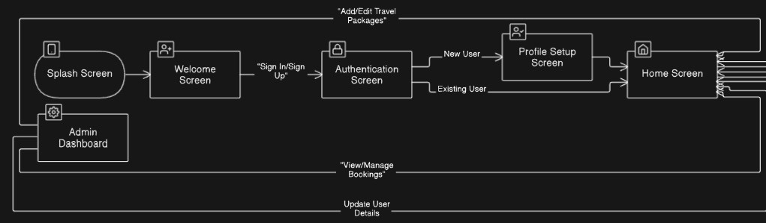
Navigation flow

Slide 7
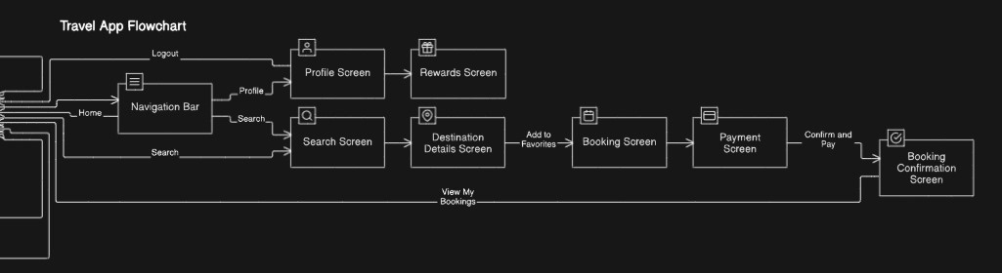

Slide 8
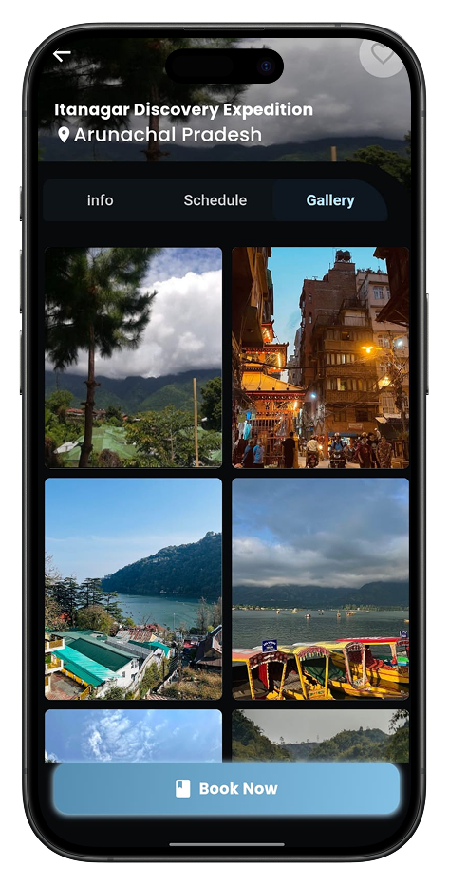
Technology Stack
OVERVIEW OF THE TECHNOLOGIES USED TO DEVELOP TRAVEL MINDS:
Flutter is used for the mobile app's frontend.
React.js is used for the web application's frontend.
Dart is the programming language used with Flutter for the mobile app's logic.
Python with Flask is used for the web application's backend.
MongoDB is the database for storing data.
Firebase Authentication handles user authentication.
Razorpay is integrated for payment processing.
Imagekit.io is used to store images of package in cloud

Slide 9

Admin Panel
THE TRAVEL MINDS ADMIN PANEL PROVIDES COMPREHENSIVE TOOLS FOR MANAGING THE APPLICATION'S CONTENT AND OPERATIONS. ADMINISTRATORS CAN EFFICIENTLY ADD AND UPDATE TRAVEL PACKAGES, GAIN INSIGHTS FROM TRENDING DATA VISUALIZED IN GRAPHS, ACCESS DETAILED USER BOOKING INFORMATION, AND UTILIZE A DASHBOARD THAT OFFERS A CONSOLIDATED VIEW OF KEY METRICS AND AVAILABLE TRAVEL PACKAGES

Slide 10
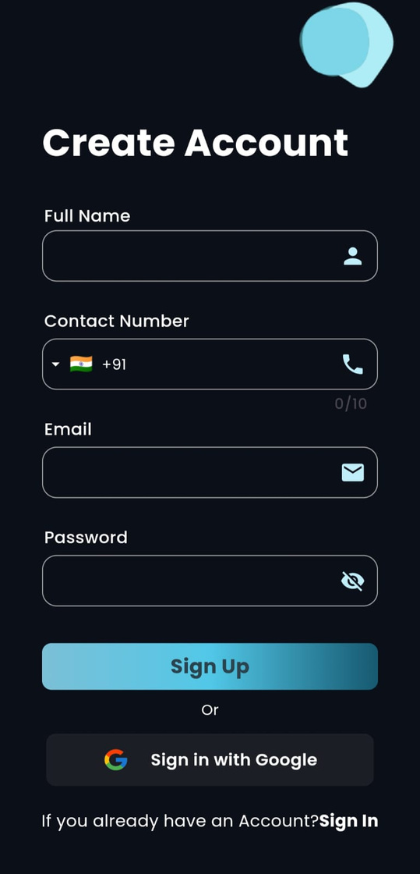
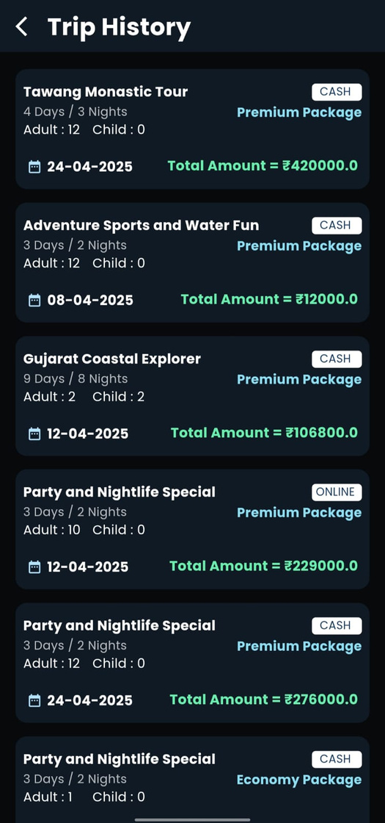
Benefits
Seamless Booking: Effortless booking of hotels, and packages with secure payment options.
Personalized Recommendations: Tailored travel suggestions and packages based on user preferences.
Real-time Updates: Instant notifications and updates on booking status and travel information.
Secure Authentication: Secure login with Google and email/password options, protecting user data.
Comprehensive Travel Information: Detailed insights into destinations, itineraries, and package inclusions.

Slide 11
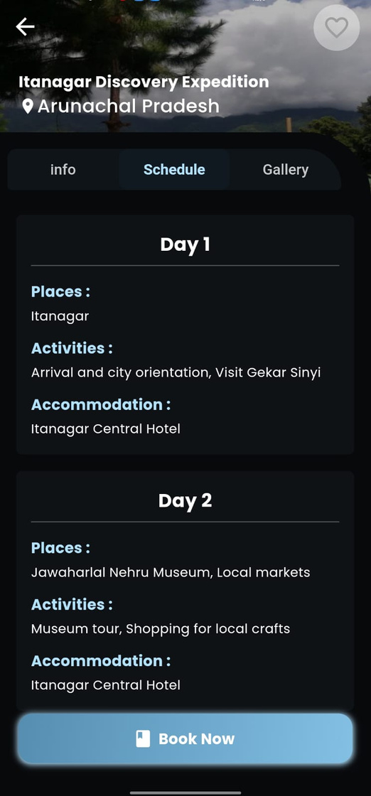
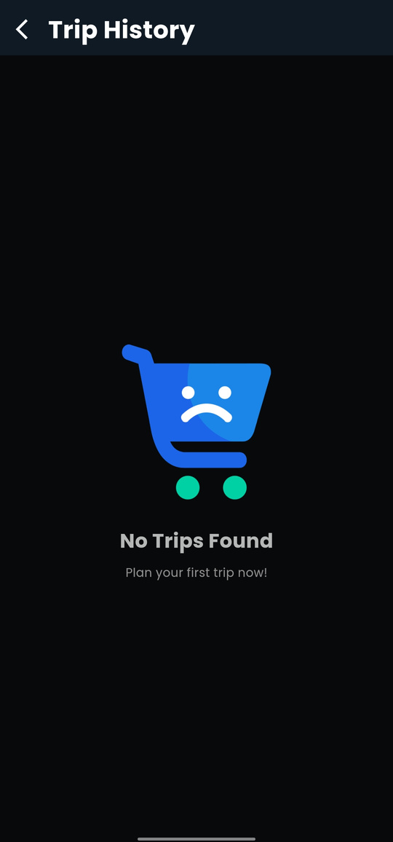
Limitations
Dependency on Internet: Requires a stable internet connection for full functionality, limiting use in areas with poor connectivity.
Potential Scalability Concerns: May face performance slowdowns with a large number of concurrent user.
Reliance on Third-Party Services: Heavily dependent on external services like Firebase and Razorpay, making it vulnerable to their downtimes.
Security Vulnerabilities: Processing sensitive user data and payments introduces potential security risks.
Backend Complexity: Managing the backend with Flask and MongoDB requires ongoing maintenance and monitoring

Slide 12
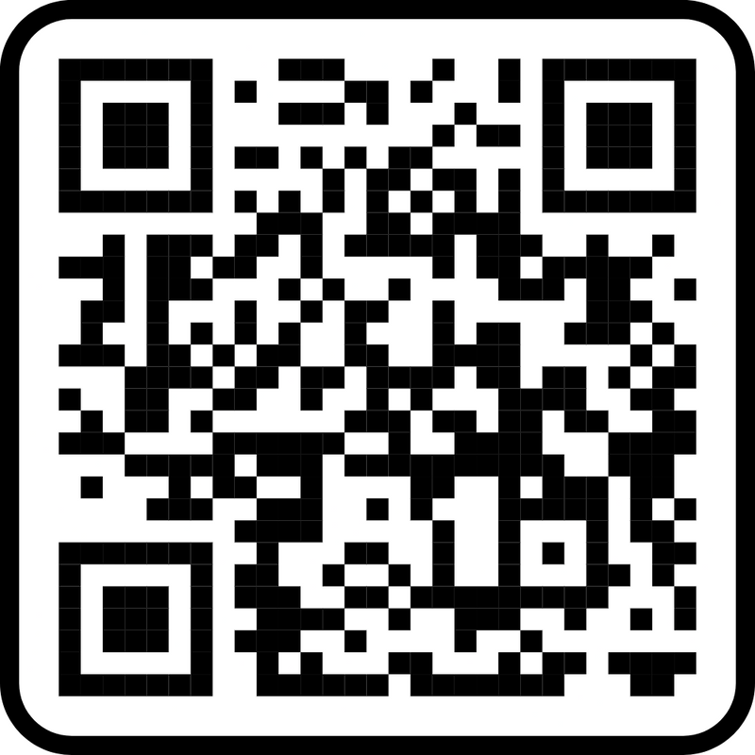
Use Case Diagram
The Use Case Diagram visually represents the interactions between users (both customers and administrators) and the Travel Minds system. It provides a blueprint for understanding the functional requirements of the application and illustrates how users engage with key functionalities, such as user authentication, travel booking, profile management, and admin operations.
Get detailed view here.

Slide 13
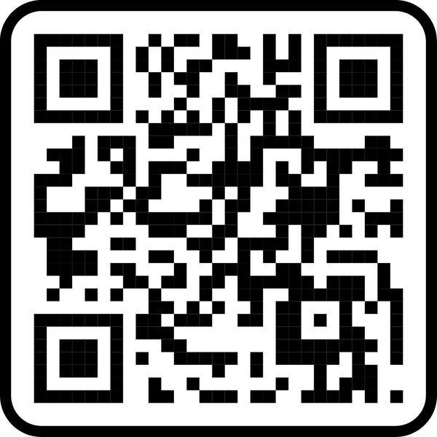
ER Diagram
This Entity-Relationship (ER) diagram provides a structured overview of the data entities within the Travel Minds application. It effectively shows the relationships between them, which is essential for understanding how data is organized and connected within the system's database.

Slide 14

Data Dictionary
THE DATA DICTIONARY PROVIDES A CENTRALIZED REPOSITORY OF INFORMATION ABOUT THE DATA USED WITHIN THE TRAVEL MINDS APPLICATION. IT OFFERS DETAILED DESCRIPTIONS OF DATA ELEMENTS, THEIR TYPES, FORMATS, AND CONSTRAINTS, ENSURING CONSISTENCY AND CLARITY ACROSS THE SYSTEM. THIS DOCUMENTATION IS CRUCIAL FOR DEVELOPERS AND DATABASE ADMINISTRATORS, AS IT FACILITATES EFFICIENT DATA MANAGEMENT, PROMOTES DATA INTEGRITY, AND SUPPORTS SEAMLESS INTEGRATION BETWEEN DIFFERENT APPLICATION MODULES.

Slide 15

DFD Diagram
The Data Flow Diagram (DFD) visually represents the flow of data within the Travel Minds system. It provides a clear and concise depiction of how information moves between users, system processes, data stores, and the admin, illustrating the interactions and data transformations that occur within the application

Slide 16

Future Scope & Planning
AI RECOMMENDATIONS: PERSONALIZED TRAVEL SUGGESTIONS AND ITINERARY PLANNING.
AR PREVIEWS: VIRTUAL TOURS OF DESTINATIONS AND HOTELS.
VOICE/CHATBOT: AI ASSISTANTS FOR NAVIGATION AND BOOKING SUPPORT.
BLOCKCHAIN SECURITY: SECURE TRANSACTIONS AND POTENTIAL CRYPTOCURRENCY PAYMENTS.
GLOBAL SUPPORT: MULTI-CURRENCY AND MULTI-LANGUAGE FUNCTIONALITY.
SMART INSURANCE: REAL-TIME, CUSTOMIZED TRAVEL INSURANCE OPTIONS.
ENHANCED REWARDS: TIER-BASED PROGRAMS AND GAMIFIED ENGAGEMENT.
OFFLINE ACCESS: OFFLINE ACCESS TO ITINERARIES AND ESSENTIAL TRAVEL INFORMATION.
COMMUNITY FEATURES: SOCIAL SHARING, REVIEWS, AND GROUP TRIP PLANNING

Slide 17

Conclusion
In summary, Travel Minds offers a user-friendly platform that simplifies the entire travel experience. Key features like seamless booking, personalized recommendations, secure authentication, and comprehensive travel information empower users to plan and enjoy their journeys with ease.
Travel Minds aims to redefine travel by providing a comprehensive solution that combines convenience, exploration, and rewards, all within a secure and efficient application.

Slide 18
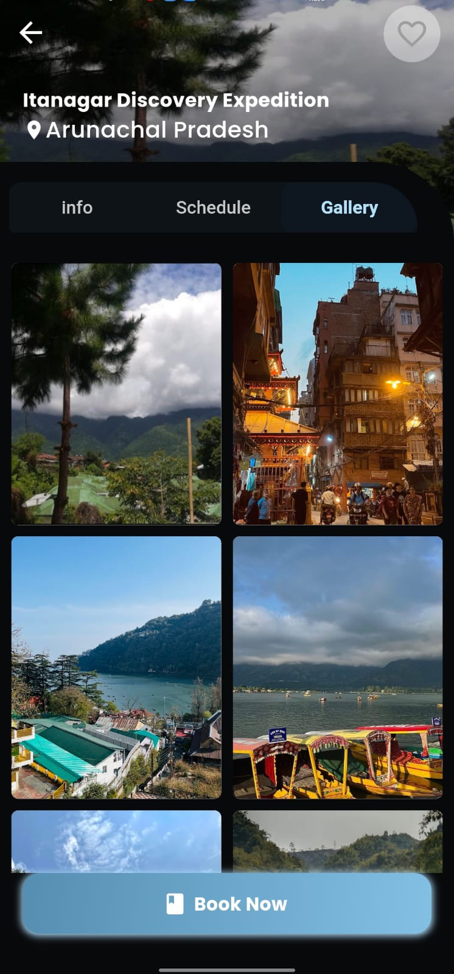
Thank you for your time. Are there any questions?

